Slide 1
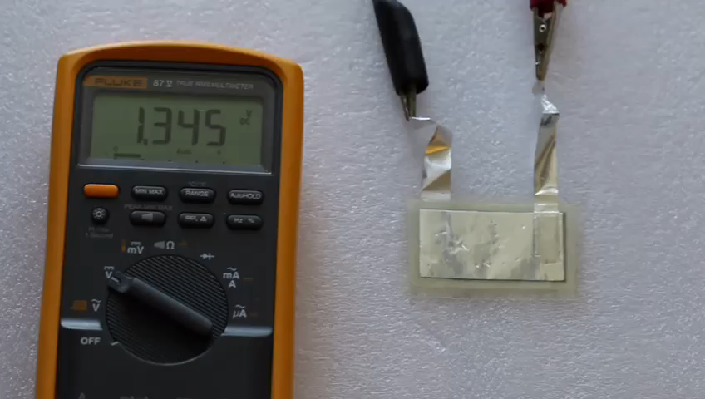
Movie 2
Mingqiang Wang, Ahmet Emre, Siuon Tung, Alycia Gerber, Dandan Wang, Yudong Huang, Volkan Cecen, Nicholas A. Kotov, Biomimetic Solid Electrolyte for Damage-Resistant Corrugated Structural Batteries, ACS Nano, in revision.

